Slide 1
Clustering Spatial Transcriptomics Data
Keerthi Panguluri, Toby Hess, Jeffrey Liu

Slide 2
The Data
(or, what are we trying to cluster?)

Slide 3
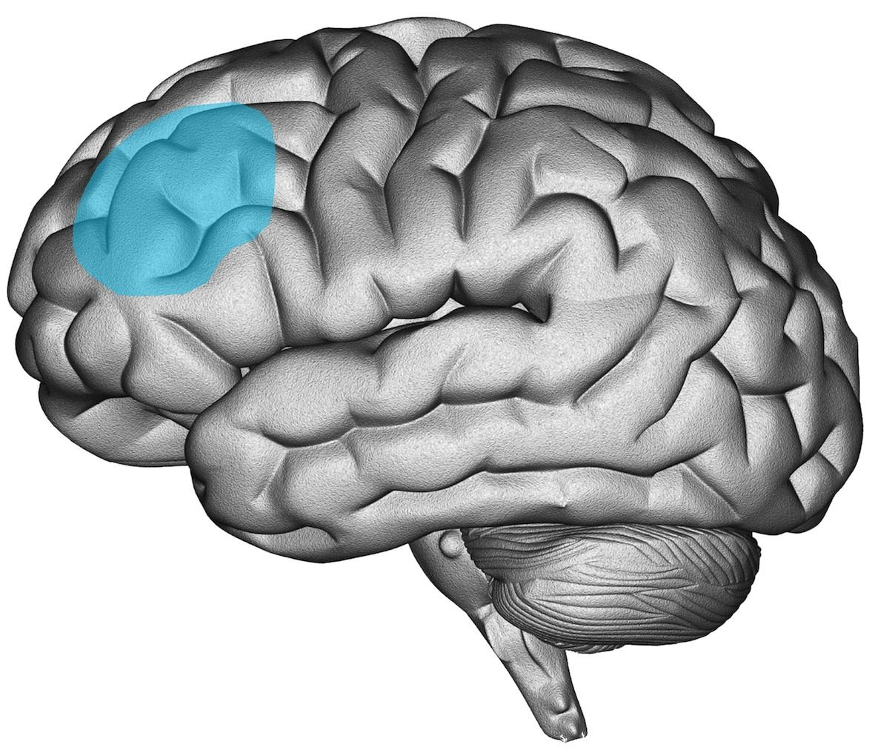
The Data
3460 cells
human
dorsolateral prefrontal cortex
7 layers
33538 RNA transcripts sequenced
12226 have no expression data for any cell!
spatial information
x and y coordinates

Slide 4
Basic Methods
(or, what if we only paid attention to one lecture?)

Slide 5
Basic Methods
normalization
normalize the counts (each cell has same number of transcripts)
log-normalize the counts (make distribution more Gaussian)
z-score normalize location data
k-means clustering
hierarchical clustering
AgglomerativeClustering
Gaussian mixture models

Slide 6
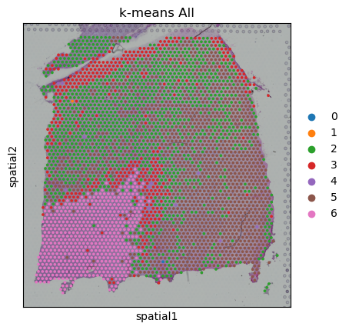
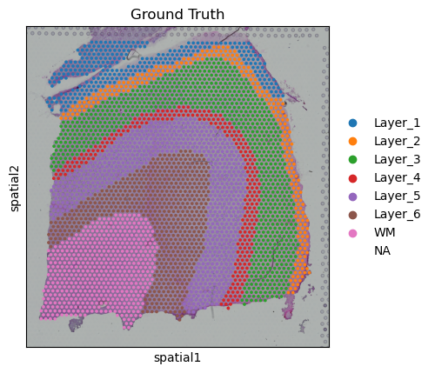
Basic Methods: k-means Clustering
ARI = 0.18

Slide 7
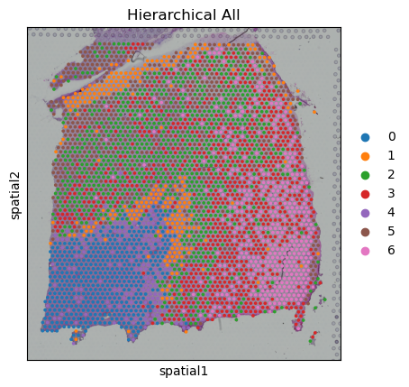
Basic Methods: Hierarchical Clustering
ARI = 0.18

Slide 8
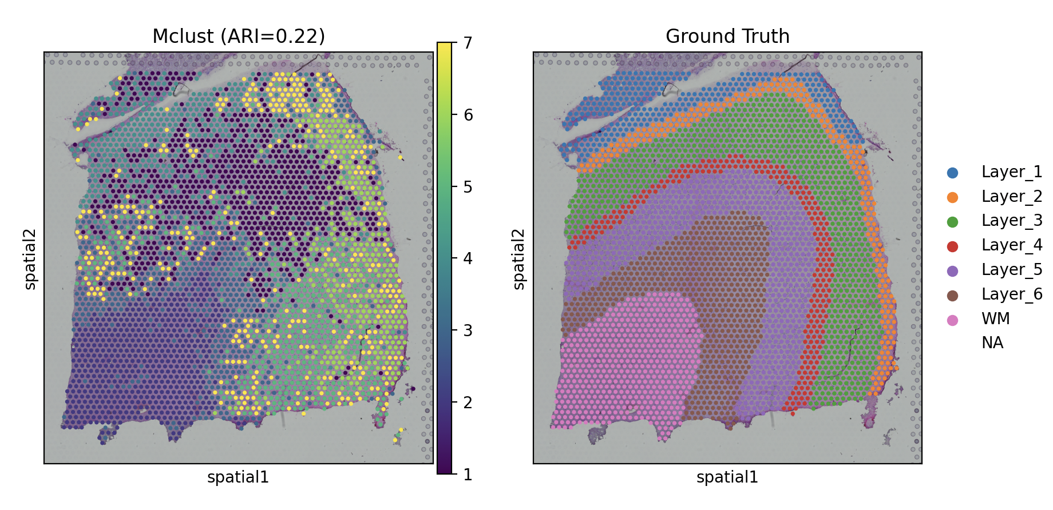
Basic Methods: Gaussian Mixture Model (GMM - Mclust)
ARI = 0.22

Slide 9
Basic Methods: Dimensionality Reduction
by themselves, k-means, GMM, and hierarchical clustering are not so good
Euclidean distances are not meaningful in high dimensions
dimensionality reduction: capture most variance with fewer variables
PCA
t-SNE
UMAP
Isomap

Slide 10
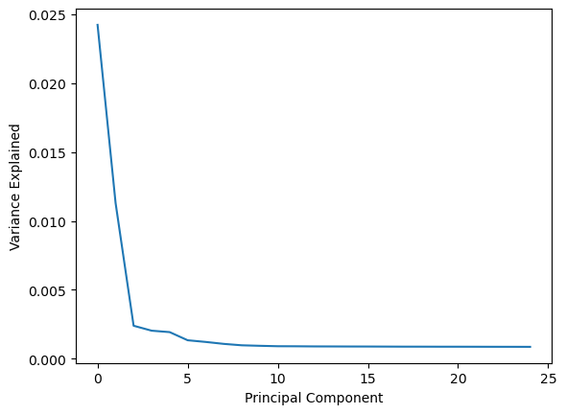
Basic Methods: PCA
linear method
keep components to account 95% variance
2791 components

Slide 11
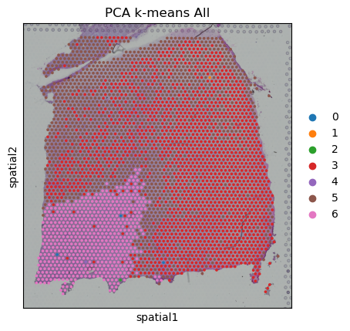
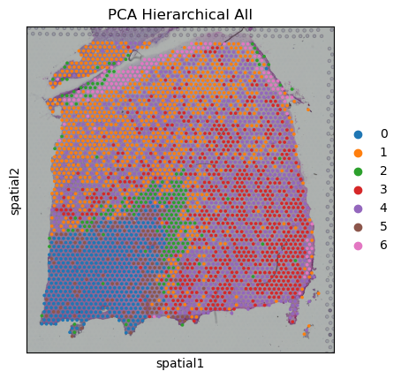
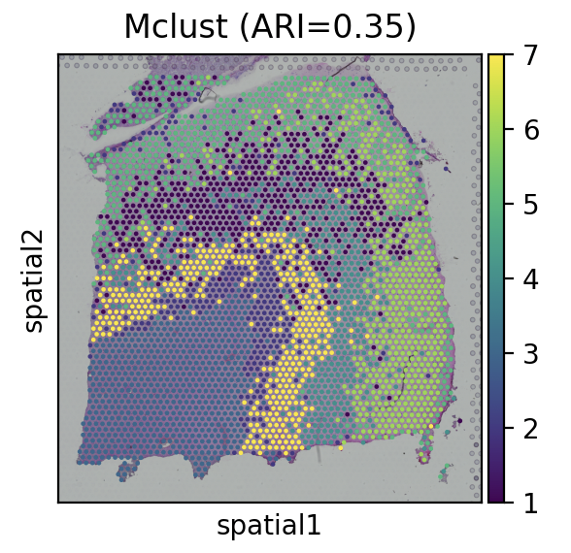
Basic Methods: PCA
ARI = 0.18
ARI = 0.17
ARI = 0.35

Slide 12
Basic Methods: Nonlinear Methods
maybe linear methods cannot capture the relationships in transcriptomic data
try nonlinear methods
downside: algorithm takes longer
might not be the same each time! (t-SNE)
computational resources forces us to use fewer components

Slide 13
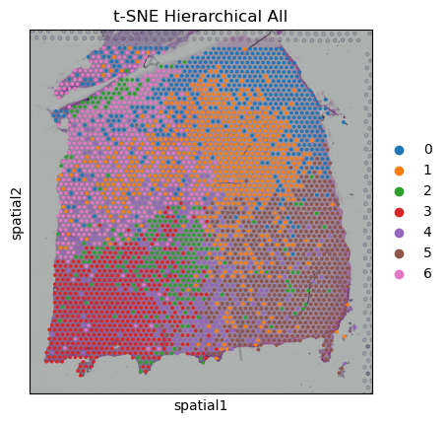
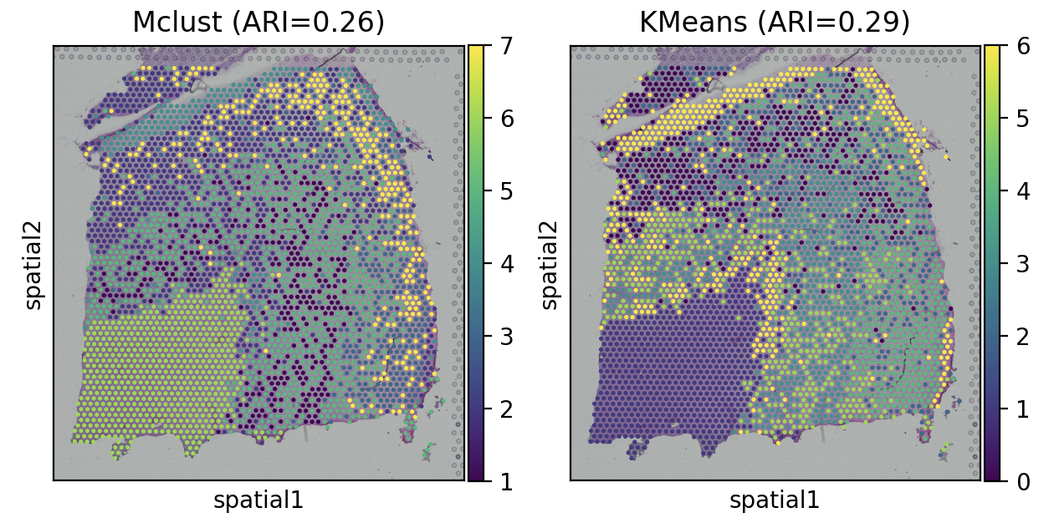
Basic Methods: t-SNE
ARI = 0.18
ARI = 0.26
ARI = 0.29

Slide 14
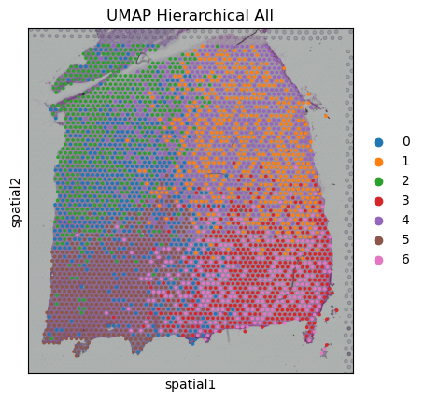
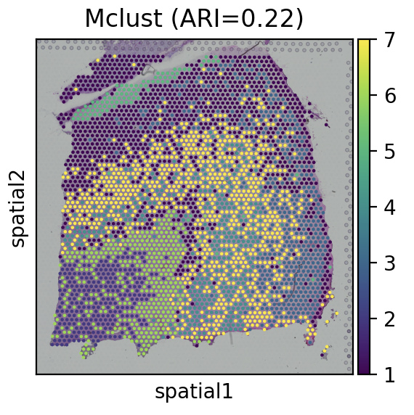
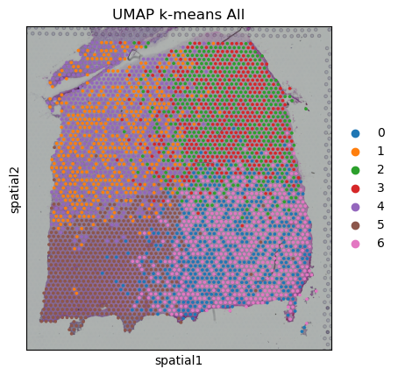
Basic Methods: UMAP
ARI = 0.13
ARI = 0.22
ARI = 0.15

Slide 15
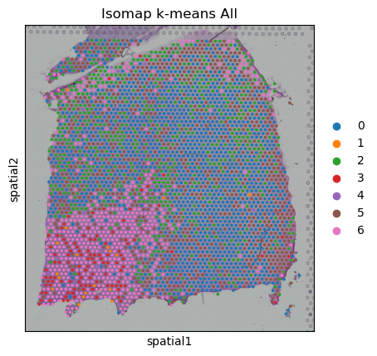
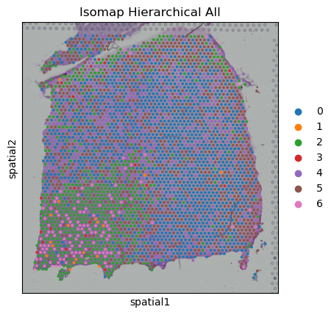
Basic Methods: Isomap
ARI = 0.10
ARI = 0.10

Slide 16
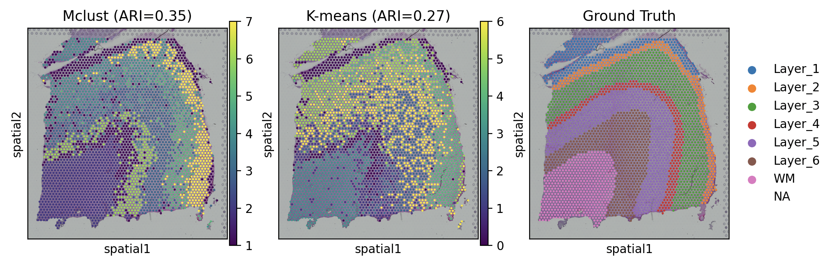
Combination of Dimension Reductionalities: PCA + UMAP
ARI = 0.35
ARI = 0.27

Slide 17
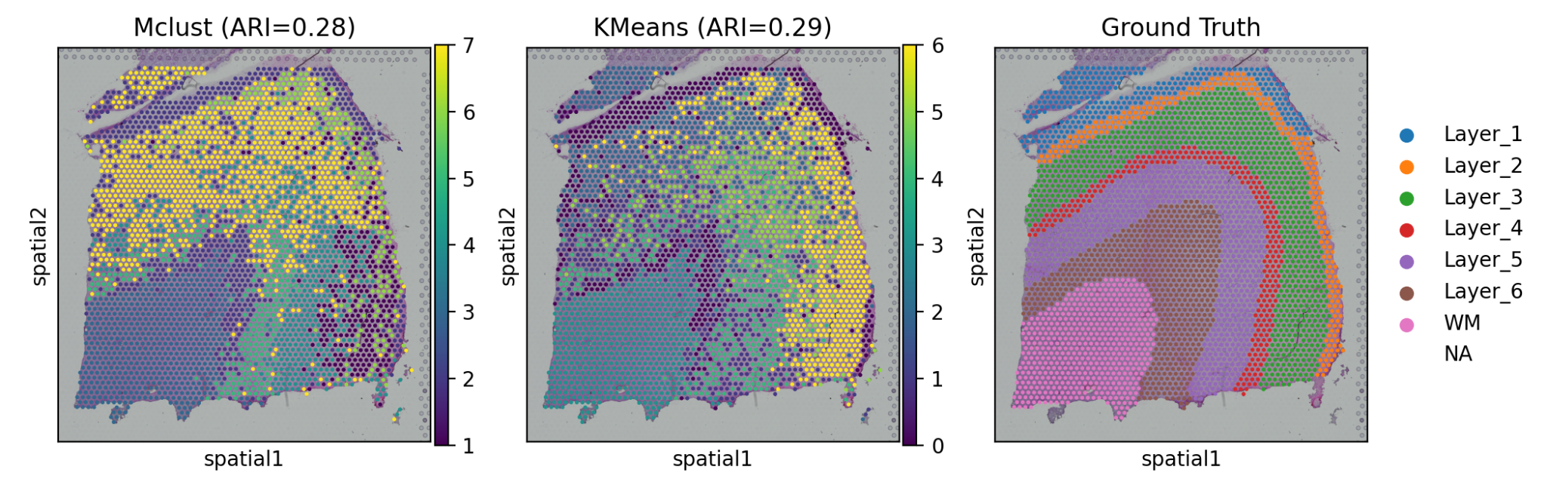
Combination of Dimension Reductionalities: PCA + t-SNE
ARI = 0.28
ARI = 0.29

Slide 18
Basic Methods: Conclusion
clearly, something is not working
two roads:
distance metrics
data imputation

Slide 19
Distance Metrics
(or, how far is far?)

Slide 20
Distance Metrics
finding a good metric for clustering scRNA data is hard
sparse
high-dimensional
high variability
transcript counts within cells
transcript counts across cells
while some methods can be used to adjust for these (e.g. normalization), many statistical tools aren’t built for scRNA

Slide 21
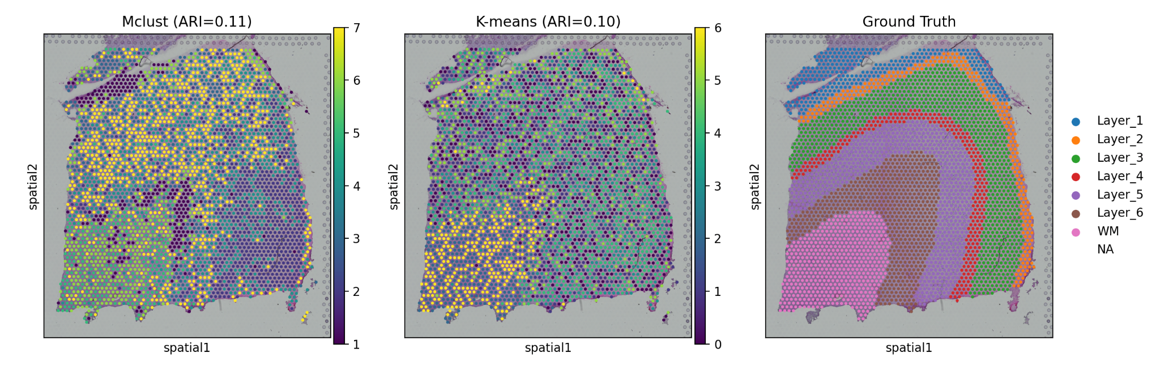
Distance Metrics: Cosine Distance
ARI = 0.11
ARI = 0.10

Slide 22
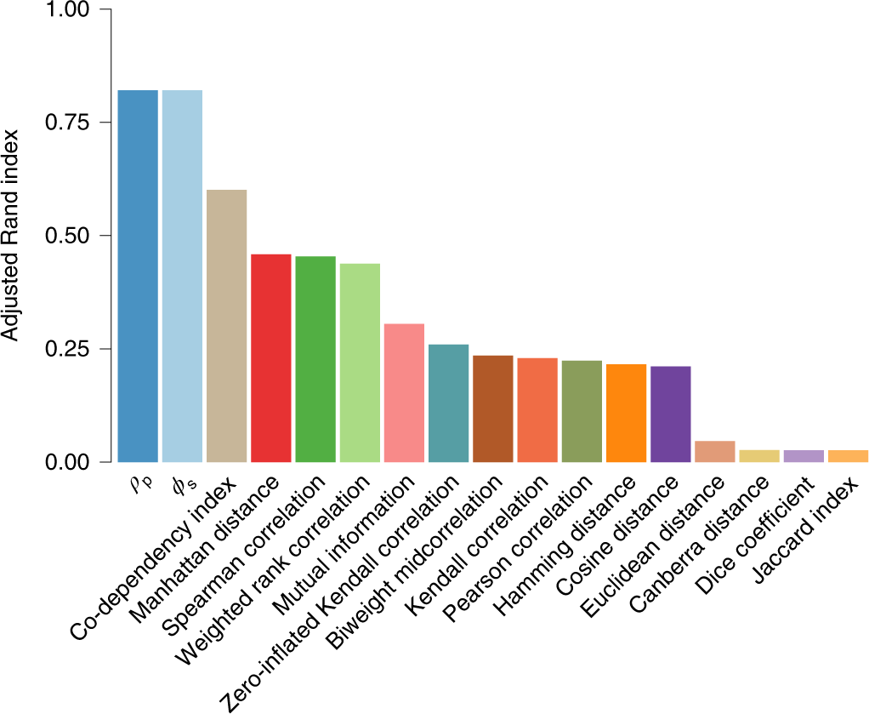
Distance Metrics: Skinnider et al. (2019)

Slide 23
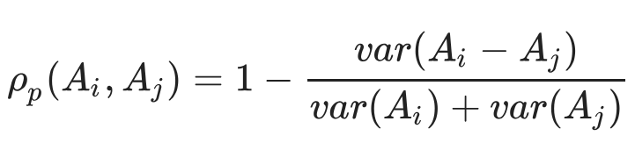
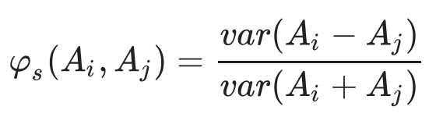
Distance Metrics: Proportionality [Quinn et al. (2017)]

Slide 24
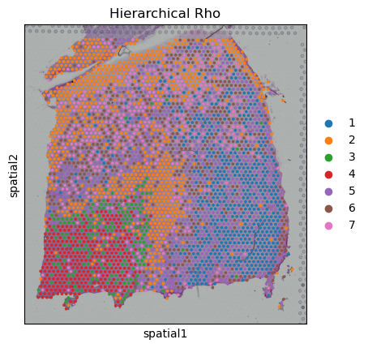
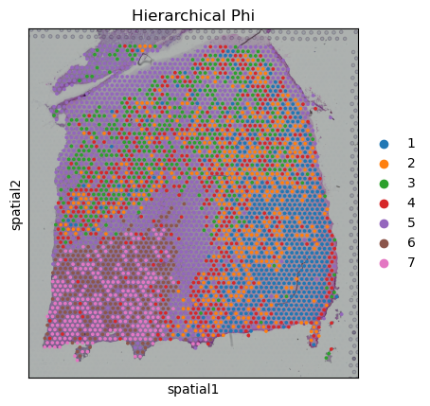
Distance Metrics: Proportionality
ARI = 0.14
ARI = 0.15

Slide 25
Data Imputation
(or, making meaning out of nothing)

Slide 26
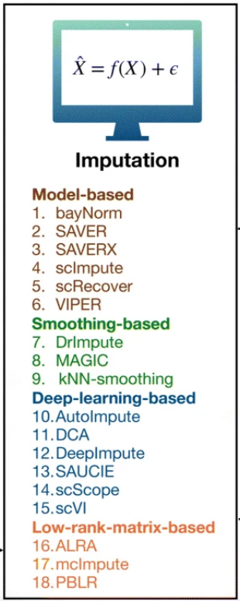
Data Imputation: Hou et al. (2020)
high % are zero!
due to dropout
4 types of tools to handle these
model-based
smoothing-based
deep-learning-based
low-rank-matrix-based

Slide 27
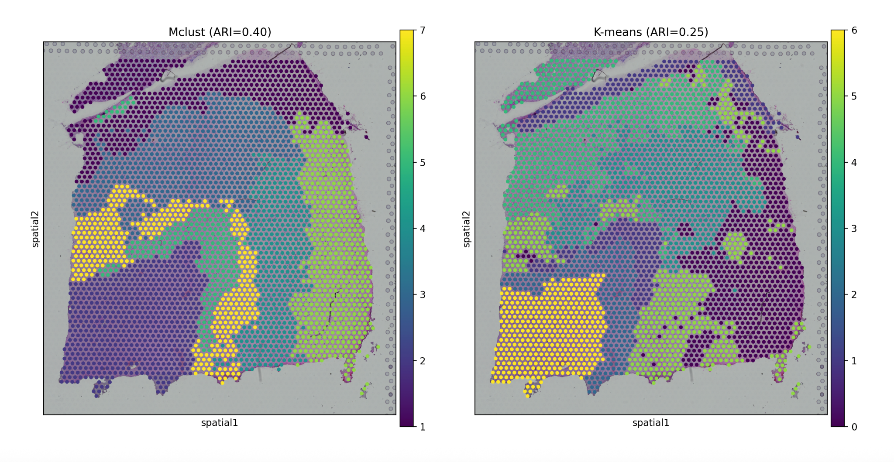
Data Imputation: VIPER [Chen & Zhou (2018)]
Mclust (ARI: 0.39)
K Means (ARI: 0.25)

Slide 28
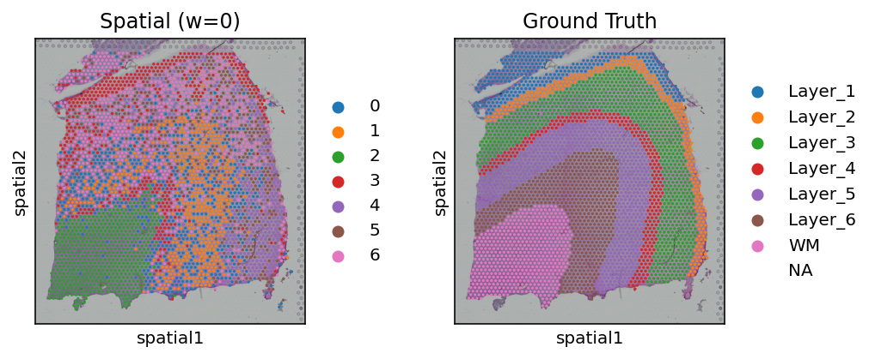
Data Imputation: MAGIC [van Dijk et al. (2018)]
ARI = 0.22

Slide 29
Data Imputation: MAGIC [van Dijk et al. (2018)]
MAGIC only takes transcriptomic data into account
we also have spatial data
introducing: spatial smoothing

Slide 30
Convolutional Filter
w | w | w
w | 1 | w
w | w | w
w ∈ 0.1*[0:10]
Tune w to get best ARI

Slide 31
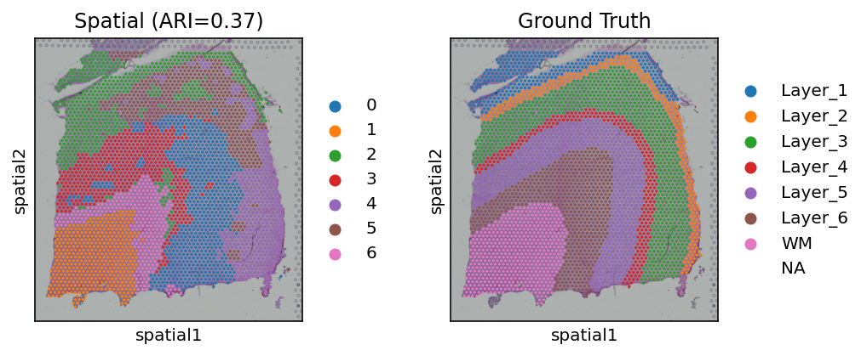
MAGIC, Spatial Smoothing (w=0.5), PCA, UMAP, k-means
ARI = 0.22
ARI = 0.37

Slide 32
Conclusions
best ARI = 0.39
basic methods perform similarly
large data set → dimensionality reduction important for practical computation
imputation is important to handle dropout genes
spatial smoothing significantly improved performance of algorithm

Slide 33
References
Chen, M., Zhou, X. (2018). VIPER: variability-preserving imputation for accurate gene expression recovery in single-cell RNA sequencing studies. Genome Biol, 19(196). https://doi.org/10.1186/s13059-018-1575-1
Hou, W., Ji, Z., Ji, H., & Hicks, S. C. (2020). A systematic evaluation of single-cell RNA-sequencing imputation methods. Genome Biology, 21(1). https://doi.org/10.1186/s13059-020-02132-x
Quinn, T. P., Richardson, M. F., Lovell, D., & Crowley, T. M. (2017). Propr: An R-package for identifying proportionally abundant features using compositional data analysis. Scientific Reports, 7(1). https://doi.org/10.1038/s41598-017-16520-0
Skinnider, M. A., Squair, J. W., & Foster, L. J. (2019). Evaluating measures of association for single-cell transcriptomics. Nature Methods, 16(5), 381–386. https://doi.org/10.1038/s41592-019-0372-4
van Dijk, D., Sharma, R., Nainys, J., Yim, K., Kathail, P., Carr, A. J., Burdziak, C., Moon, K. R., Chaffer, C. L., Pattabiraman, D., Bierie, B., Mazutis, L., Wolf, G., Krishnaswamy, S., & Pe’er, D. (2018). Recovering gene interactions from single-cell data using data diffusion. Cell, 174(3). https://doi.org/10.1016/j.cell.2018.05.061

Slide 34
Extra Slides

Slide 35
 | k-means | Hierarchical | GMM
Normalized Data | 0.18 | 0.18 | 0.22
PCA | 0.18 | 0.17 | 0.36
t-SNE | 0.18 | 0.26 | 0.29
UMAP | 0.13 | 0.22 | 0.15
Isomap | 0.10 | 0.10
PCA + t-SNE | 0.29 |  | 0.28
PCA + UMAP | 0.27 |  | 0.35
PCA + UMAP (cosine) | 0.10 |  | 0.11
Proportionality, ρ_{p} |  | 0.14
Proportionality, ϕ_{s} |  | 0.15
VIPER | 0.25 |  | 0.39
MAGIC | 0.22
MAGIC + spatial smoothing | 0.37

